Slide 1
European website cms: Contentstack
Session 1: Optimisation
Notes:
2018 we started working with Kentico
2019 Q1 all websites went live
2020 November we removed Kentico Cloud to fix performance issues
2021 November Kentico 11 went out of support

Slide 2
Session 1: Optimisation
Agenda:
Introduction CMS/headless
Migration status/examples
Optimisation task overview
Glossary
UI/Overview
Types (Page, Product, News, Blog, Dealer, …)
Language/locales (master)
Save filter/search
Coffee Break!
TODAY: just listen carefully! You will receive access to your site tomorrow morning including support material!
Create page
Create/Editing (Blocks, fields)
Views: live vs. preview
Save, publish, unpublish, delete
Versions
Optimization process
Microcopy/Navigation/Footer
Support Process

Slide 3
Please be aware:
Contentstack provides us with alot of new opportunities!
The current setup is a great first step, now it is up to all of us to shape this technology to power our digital marketing activities.
We will re-start our European Website Core Team to build a roadmap together, based on your needs and to increase the user experience on all websites.
All ideas and wishes will be captured and discussed and prioritized in this team.

Slide 4
Preliminary high level website structure
Hardware
Digital Workplace
Professional Printing
Healthcare
News
Career
Corporate Information
Office
Cloud Services
Markets
Hardware
Explore us as an employer
Events
Professional Printing
Security Services
Hardware
Solutions
ESG
Managed IT Services
Software
Create the future business together with us
About us
Managed Application Services
Services
Other business areas
Igniting Print Possibilities Blog
Transform Konica Minolta as a student,young professional or professional
Global Corporate Information
Collaboration & Communication
Virtual Showroom
Information Management Services
Workflow & Automation
Managed Print Services
Remote Working & Home Office
Non-negotiable items
Header
Footer
Country Gateway Page / start page layout
Remote Support
Video Solution Services
Printing Devices
Software & Services
Rethink Work Blog

Slide 5
Focus on content optimisation!
Training 1: Optimisation
3rd + 5th September
Training 2: Optimisation Part 2
10th + 12th
September
Training 3: Translation & Distribution
Early October
Training 4: Prepare for launch
Late October

Slide 6
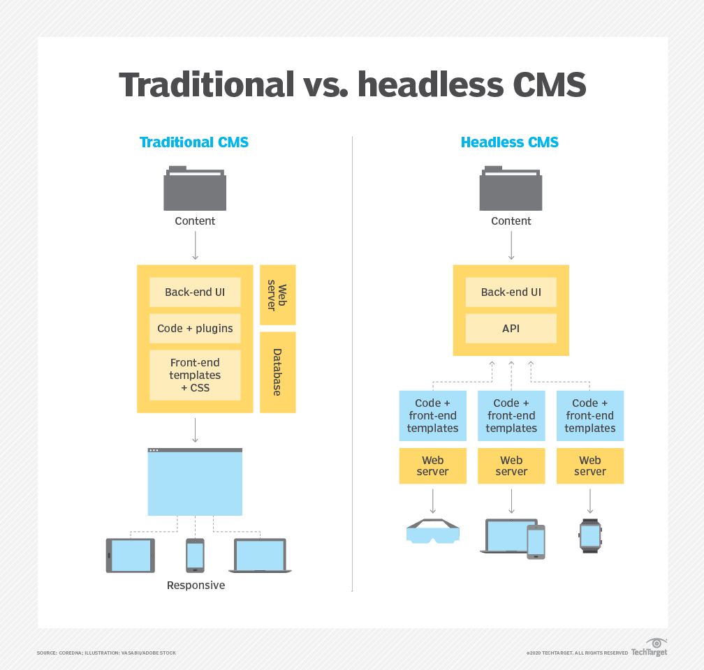
Introduction CMS/headless
Headless CMS
Decoupled frontend from backend
Speed increase
Frontend (hosted on Vercel)
Backend (hosted by Contentstack)
Opportunity to deliver content to different channels in different designs
Content Management
No page tree any longer
Entries are separated by Types
Technical improvements
Quick turnarounds for fixes/optimizations
Fast deployments
Future proof due to API integrations (AI, personalization,...)
Notes:
Timeline: View of NOC and BEU

Slide 7
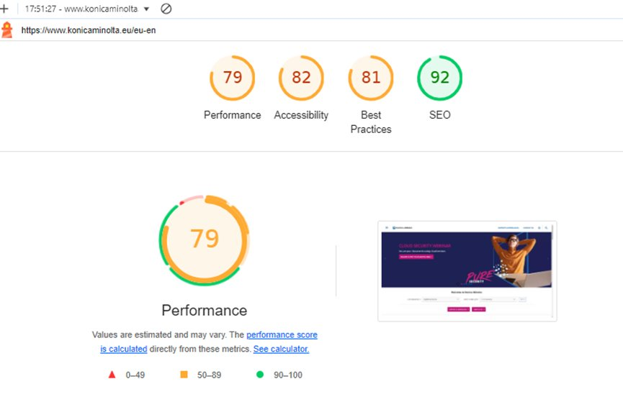
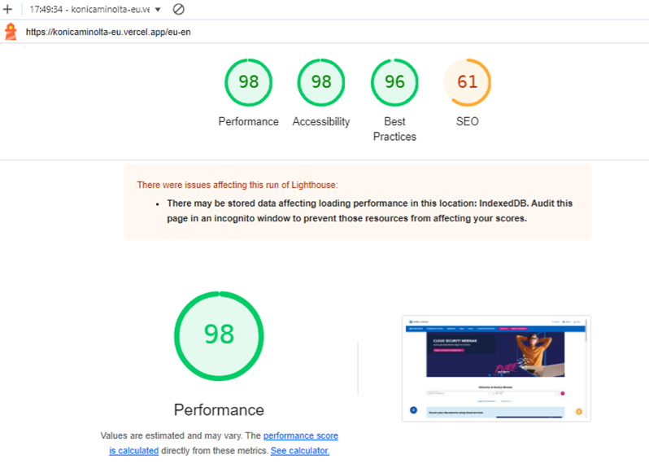
Introduction CMS/headless: Example of speed increase / Lighthouse before & after
Kentico/Azure
Contentstack/Next/Vercel*
* Headlines, alt-texts and meta data not yet optimized

Slide 8
Status: Migration
Migration
Challenges
All pages, texts and image are migrated + editable
Some repeating issues
Final migration took place on 16th of August
Manual optimizations needed

Slide 9
Comparison: Before/After Optimization I

Slide 10
Comparison: Before/After Optimization II

Slide 11
Comparison: Before/After Optimization III

Slide 12
Comparison: Before/After Optimization IV

Slide 13
Comparison: Before/After Optimization IV

Slide 14
Comparison: Before/After Optimization V

Slide 15
Optimisation task overview
How to optimize?
Trainings
Q&A sessions
Contentstack Guide
Training session recordings
Best practices
Examples
Demo page with common elements
Links
"Storybook" with all elements
FAQs
Get help
Excel template
Helps to keep track of your tasks
Ryte
Where to pay attention to:
Hero Images: no people cut off
Mobile image: dedicated mobile image needed?
Reorder content
Remove formatting
Remove manual line breaks
Remove duplicate content
Add Form background
Check/replace Blog links
Set/update Meta Data
Include OG image
https://contentstack-guide.konicaminolta.eu

Slide 16
Glossary
New CMS, new terminology:
Kentico | Contentstack | Description
- | Stack | Collection of content data
Instance | Language
Page | Entry | Piece of structured content
Template | Content Type | Blueprint for an Entry
Widget | Block | Predefined collection of fields to specify a part of an entry
Field | Field | Allows the editor to enter data
Localisation App | Microcopy | Stores template related texts

Slide 17
Support process
FAQ section on Contentstack Guide page
Please have a look at the FAQ section of this site first - maybe your questions was already answered.
Q&A sessions
Feel free to join our Q&A sessions to ask all your questions.
By email to technik@active-elements.de
Please always provide the following data:
Include URL (Contentstack and/or preview url)
detailed description of the issue
Screenshots
2nd level support by Contentstack

