Slide 1
European website cms: Contentstack
Agenda:
- Project review & status - European website structure - Technical advantages - Content Migration - Content Optimization & Trainings
Notes:
2018 we started working with Kentico
2019 Q1 all websites went live
2020 November we removed Kentico Cloud to fix performance issues
2021 November Kentico 11 went out of support

Slide 2
October 2021
Global CX2 (eCommerce) project requests CMS integration

Slide 3
February 2022
Project kick-off and scope definition

Slide 4
Global CMS Integration Partner Decision High level: Scope of Work
3 projects with certain sub-projects
#1. global eCommerce platform
Keep the current design
Content migration for existing US shop
COMMON
Frontend Development for each project (three/four different designs)
Frontend hosting via CDN
Content Modelling per project
Central technical integrations
ElasticPath
SAP Marketing Cloud
Marketo
Hubspot
MS Dynamics Marketing
Canto Cloud DAM
Algolia / Elastic
Cognigy live chat/chatbot
Inbenta chat
Lobster PIM
GoToWebinar
Usercentrics Cookie Consent Manager
RWS translation service
Roles & Responsibilities with local agencies
Define User Management / access rights and levels per project
User Trainings + (video)guidelines per project
Ticketing System / Support / SLA – define processes
website/hosting monitoring + integrations (define responsibilities)
Keep the current design
Content migration for 35 countries in 27 languages
Optimization of current issues like…
URL structure
Navigation
Page templates / restrictions
SEO options
#2. European corporate sites
+ Rethink Work blog
#3. US corporate site
Keep the current design
Potentially certain optimizations

Slide 5
July 2022
CoreTeam approved
Proof of Concept
Contentful vs. Contentstack

Slide 6
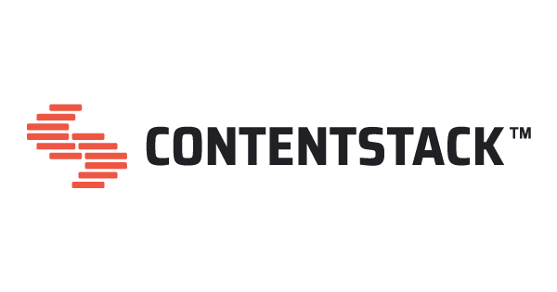
Evaluation POC – User Testing
Very intuituve, easy to use and navigate
Image manipulation and use of asset library
Flexibility in content modelling and usage
Reusable content elements
SEO setup and options
Speed / loading times
Language management
Versioning of content
Image implementation
Publishing options / scheduling / releases
live preview inside the app
better support during POC
SEO setup and options
Less userfriendly, many apps/extensions needed
No image manipulation
POC environment too limited / lack of support
Overloaded UI at first glance
Stricter content structure, less flexibility
VOTES:

Slide 7
October 2022
Select the integration partner
Kin+Carta vs. EPAM

Slide 8
Global CMS: Implementation Partner Comparison We are recommending Kin + Carta a B Corp certified technology, data and experience consultancy
Our recommendation:
Throughout the evaluation,
Kin + Carta’s extreme flexibility and "customer first" approach set them apart from the competition. They convinced with a concept that was tailored to the needs of Konica Minolta and demonstrated that we as a company could reach a new level with their innovative capacity's enabled through their partnership.
Our Requirements
Support CMS Platform
Relevant References
Business Experiences
Pricing

Slide 9
DECEMBER 2022
Signing the papers!

Slide 10
March 2023
Global CMS Project kick-off + Discovery Phase until May 2023

Slide 11
October 2023
Kin+Carta Demo of „Konica Minoltas Contentstack“ including new design system

Slide 12
February 2024
Final User Acceptance Testing

Slide 13
June 2024
Project handover from Kin+Carta to Active Elements

Slide 14
September 2024
Setup complete – ready to go!

Slide 15
What to expect?
Increased performance:
Technology enhancements:
Increased frontend speed
Easily connect existing MarTech via API
Increased backend speed
Better SEO capabilties
Faster time to market
Improved media handling
New site search engine by Algolia
Increased Web Core Vitals
Improved User Experience:
Simplified content management:
Improved site navigation
Simplified content distribution
Optimized website structure
Simplified language management & RWS machine translation
New global design system
Automated content migration

Slide 16
Let‘s get into it!
European aligned website structure

Slide 17
High level website structure
Digital Workplace
Professional Printing
Healthcare
News
Career
Corporate Information
Cloud Services
Markets
Hardware
Explore us as an employer
Events
Security Services
Hardware
Solutions
ESG
Managed IT Services
Software
Create the future business together with us
About us
Managed Application Services
Services
Other business areas
Igniting Print Possibilities Blog
Transform Konica Minolta as a student,young professional or professional
Global Corporate Information
Collaboration & Communication
Virtual Showroom
Information Management Services
Workflow & Automation
Managed Print Services
Remote Working & Home Office
Remote Support
Video Solution Services
Printing Devices
Software & Services
Rethink Work Blog

Slide 18
Technical overview and next steps
August 2024

Slide 19
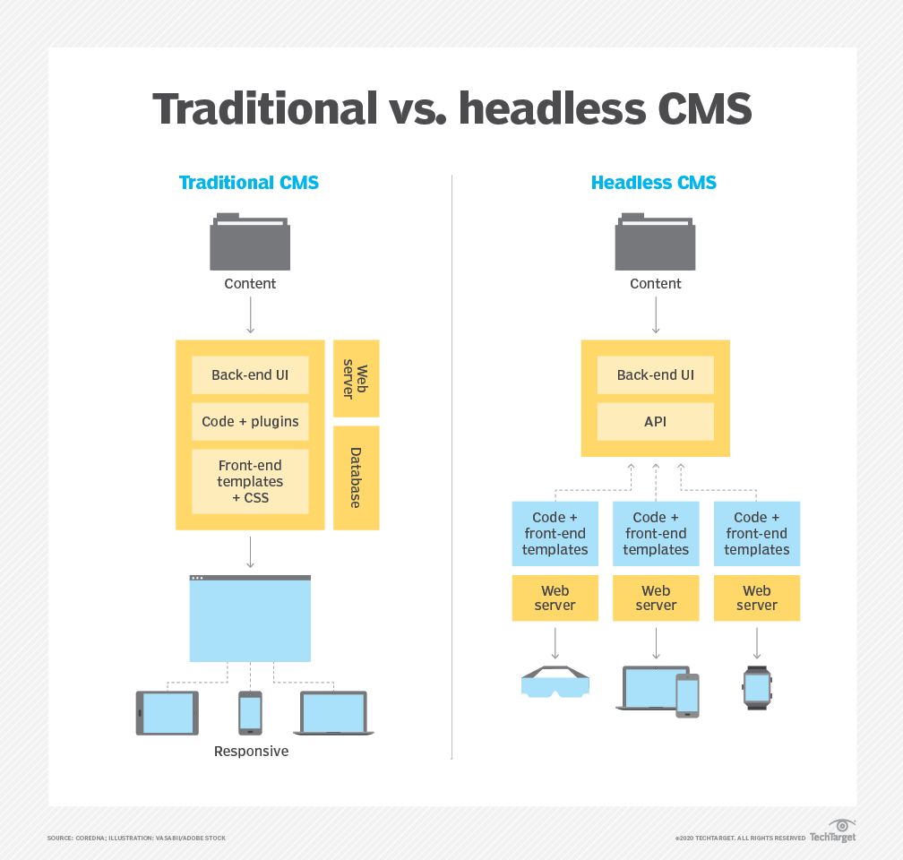
CMS: Technical advantages
Headless CMS
Code base
Speed
Frontend
Backend
Quick turnarounds for fixes/optimizations
Fast deployments
Future proof (AI)
Notes:
Timeline: View of NOC and BEU

Slide 20
Status: Migration
Examples
Home
Cloud Print Services
bizhub C3351i
Migration
Challenges
All pages, texts and image are migrated + editable
Some repeating issues
Final migration took place on 16th of August
Manual optimizations needed

Slide 21
Comparison: Before/After Optimization I

Slide 22
Comparison: Before/After Optimization II

Slide 23
Comparison: Before/After Optimization III

Slide 24
Comparison: Before/After Optimization IV

Slide 25
Comparison: Before/After Optimization IV

Slide 26
Comparison: Before/After Optimization V

Slide 27
Next steps: Optimization
How to optimize?
Trainings
Q&A sessions
Contentstack Guide
Links, news, …
Lists recommended/common optimization tasks
Excel template
Helps to keep track of your tasks
Demo page with common elements
Storybook with all elements
Ryte
September
October
November
December
Training Sessions
Q&A Sessions
Launch preparation
Additional information sessions
NOC website relaunches until mid-December

