Slide 1
European website cms: Contentstack
Training Session #3

Slide 2
Agenda for today
Reminder and process of requesting new features
Updates on currently reported issues
Rejected requests
Current TOP 3 updates
Training:
How to achieve the intended website structure
Content Distribution from BEU to NOCs and between NOCs
DealerLocator - how it has been migrated and how to make the new DealerLocator available
Timeline/Roadmap
Q&A

Slide 3
Reminder on project priorities
September
October
November
December
January
February
March
Work through all existing pages in Contentstack
By page structure
Use Kentico sitemap / Kentico backend / Frontend / URL list from Ryte
Type by type
All product pages, blog pages, all news pages, all event pages,…
Add all pages and URLs to the Excel template provided here or similar overview
Focus on getting the migrated pages to “good” status, not “perfect”!
Keep the amount of work as low as possible
You will never be “ready”, there is always something to improve
Mind the gap – keep the timeframe between migration and launch as short as possible. Reduce double work in two CMS!
Avoid creating new content before the launch
It is a good time to remove old/unused content!
It is NOT a good time to create new content!
+++ Reminder +++
Use the BEU website structure as a template to build your local structure
Download BEU structure here: https://contentstack-guide.konicaminolta.eu/cg-en/best-practices
Take the chance to look at website of other NOCs
You can use these links and change the country codes:
https://konicaminolta-preview.vercel.app/eu-en/
https://konicaminolta-preview.vercel.app/fr-fr
https://konicaminolta-preview.vercel.app/hu-hu
…
The ICW/Digital Workplace structure hasn’t been implemented by many NOCs – we used the chance at that time to merge solution and service pages!
There is no solution, software, hardware, service page any longer – only page and product page to build your structure!

Slide 4
Process of requesting new features
Opportunities to optimize content elements, templates, features and processes
Collect and report!
Process to request new features
send email to Tino
Ticket will be created and marked as “to be prioritized”
Website Core Team prioritizes tickets
Roadmap will be updated and communicated here

Slide 5
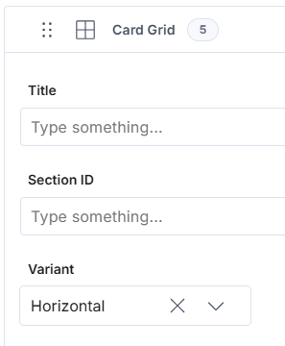
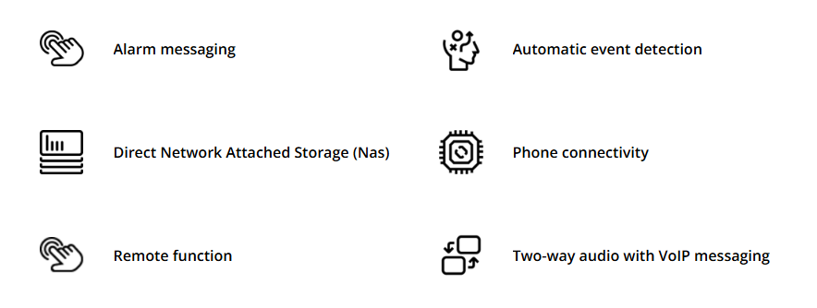
Updates on currently reported issues
Copying blocks with RTE fields is now working
Contentstack created the new block with the same ID
Card Grid variant “horizontal” available
Styling of tables in RTE is in progress
UI issues related to preview
we are investigating and trying to reproduce
you see all changes in the editor and can workaround with “save and reload”

Slide 6
Rejected requests
Remigration of content is NOT possible
New widgets/features requested
priorization by Website Core Team, will be added to roadmap
Content alignment of headlines and texts
by design the content is left aligned, based on readability
only the icon card grid can be centered
Updates to the design or creating variants will be prioritized by the Website Core Team

Slide 7
Current TOP 3 updates we are working on
Marketo Forms
Integration in Contentstack will be optimized/JavaScript updated
No action item on your side – this will be fixed globally
Algolia index is enabled
All items will be re-indexed (old entries will disappear)
new pages will be indexed when published to “production”
Product page template will get a new “Sections” area below the specifications
Other templates will be reviewed as well

Slide 8
Training session by Tino
How to achieve the intended website structure
Content Distribution from BEU to NOCs and between NOCs
Dealer Locator - how it has been migrated and how to make the new Dealer Locator available

Slide 9
Timeline/Roadmap – 21 responses!
December
January
February
March
SEU
BEU
BRO
BBG
BES
BTR
BGB
BCZ
BSK
BFI
BPT
BPL
BUR
BNO
BHN
BD/BAT
BBE/BNL
BF
BGR
BIT
BDK
Training Session #4
Prelaunch activities
Should we offer more Q&A sessions during the next weeks?

Slide 10
Now it is your turn…
Q&A

