Slide 1
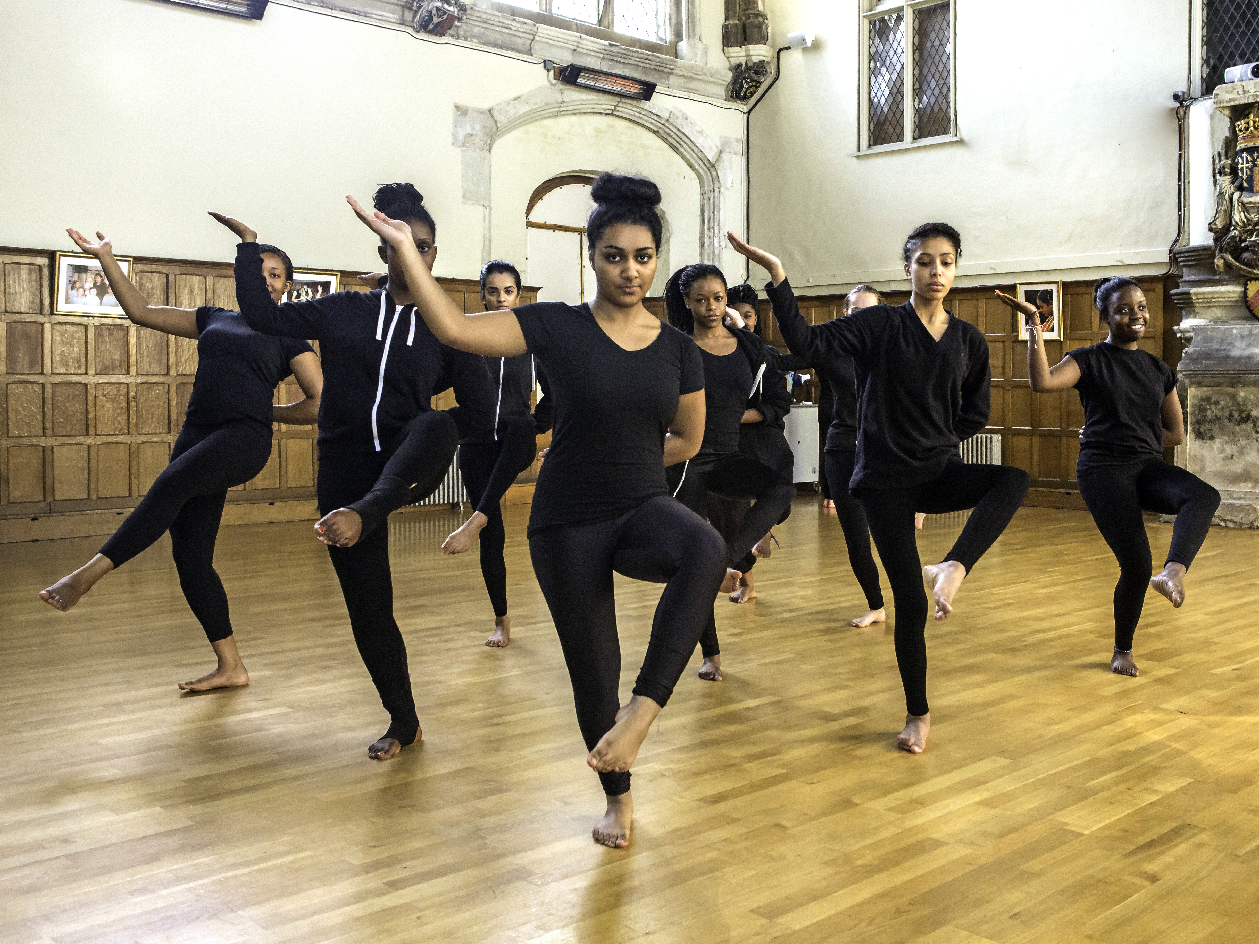
Arts Award
Presentation
Notes:
This presentation is designed to help you to introduce Arts Award to senior leaders, colleagues, parents or young people. Feel free to adapt it to tailor it to your centre’s approach and priorities.

Slide 2
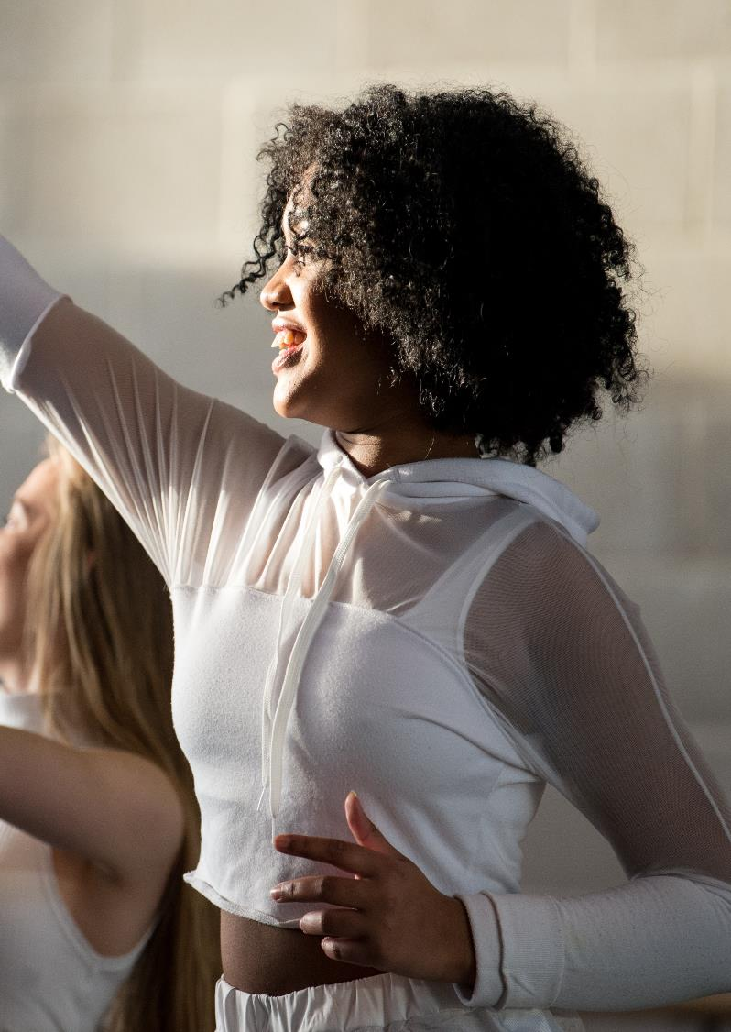
What is Arts Award?
A set of unique qualifications for young people aged 25 and under, which can be achieved at five levels: Discover, Explore, Bronze, Silver and Gold
The awards framework helps young people to develop as artists and arts leaders
The awards assess young people’s creative, communication and leadership skills
Notes:
This slide introduces the basics of what Arts Award is: a set of unique qualifications, a flexible framework which supports young people’s development, which assesses their creative, communication and leadership skills.
More detail about what young people do is included later in the presentation.

Slide 3
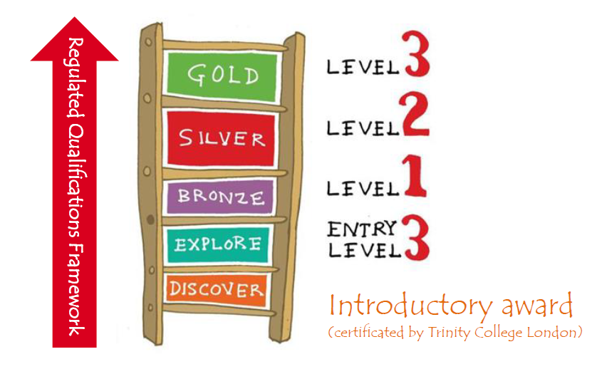
Arts Award levels
Arts Award can be offered at five levels, one introductory award and four regulated qualifications
Two levels have been developed with primary school aged children in mind
Learners can progress through all five levels, or start at the level most suited to them
At Gold level, students can achieve 16 UCAS points with Arts Award

Slide 4
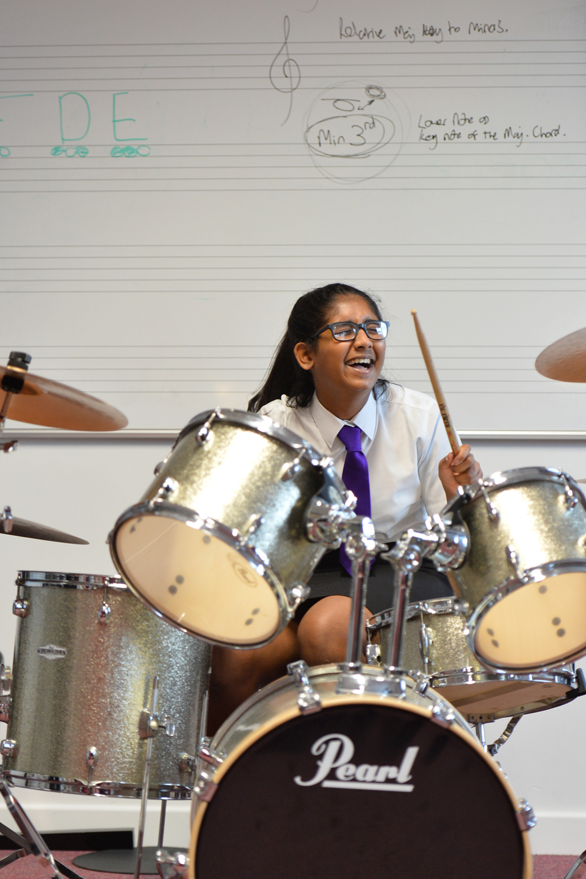
Why is Arts Award valuable?
Qualification information
Discover is an introductory certificate
Explore is an Entry Level 3 qualification
Bronze is a Level 1 qualification
Silver is a Level 2 qualification
Gold is a Level 3 qualification (16 UCAS points attached)
Notes:
A qualification factsheet with more information is available to download at artsaward.org.uk/qualification. You can see how the awards compare in size to other qualifications at http://www.artsaward.org.uk/site/?id=2056

Slide 5
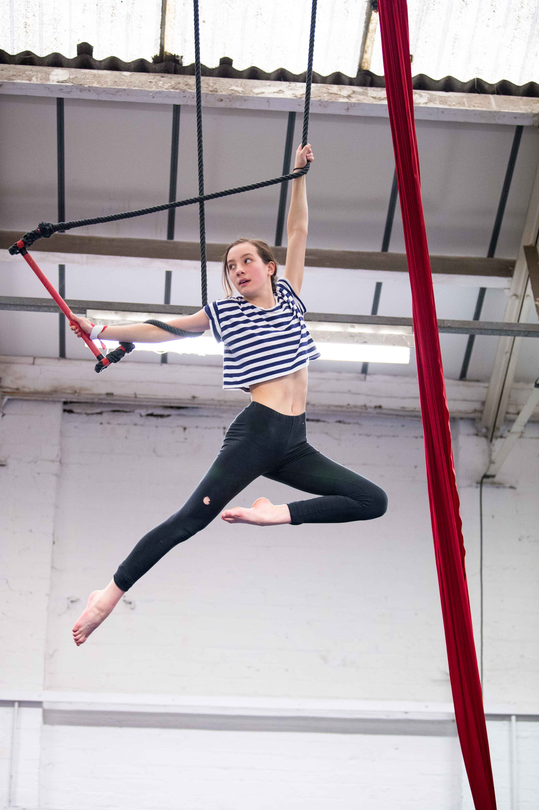
What young people do
Take part in arts activities
Find out about artists and arts organisations
Attend and review arts events
Research careers and opportunities
Develop their communication skill
Plan and lead their own arts projects
Reflect on their progress as they go along, recording and evidencing their learning
Notes:
Explain what’s involved in achieving an Award, and that young people collect and present evidence of their progress as they go along.
Emphasise that Arts Award is a personalised qualification which recognises individual development and reflection – the young people will not be assessed on how good they are at their art form, but on their own progress and commitment to developing their arts skills, knowledge and understanding.
Achieving an Arts Award says a lot about a young person: that they are committed, independent, interested in developing new skills and willing to take on challenges.

Slide 6
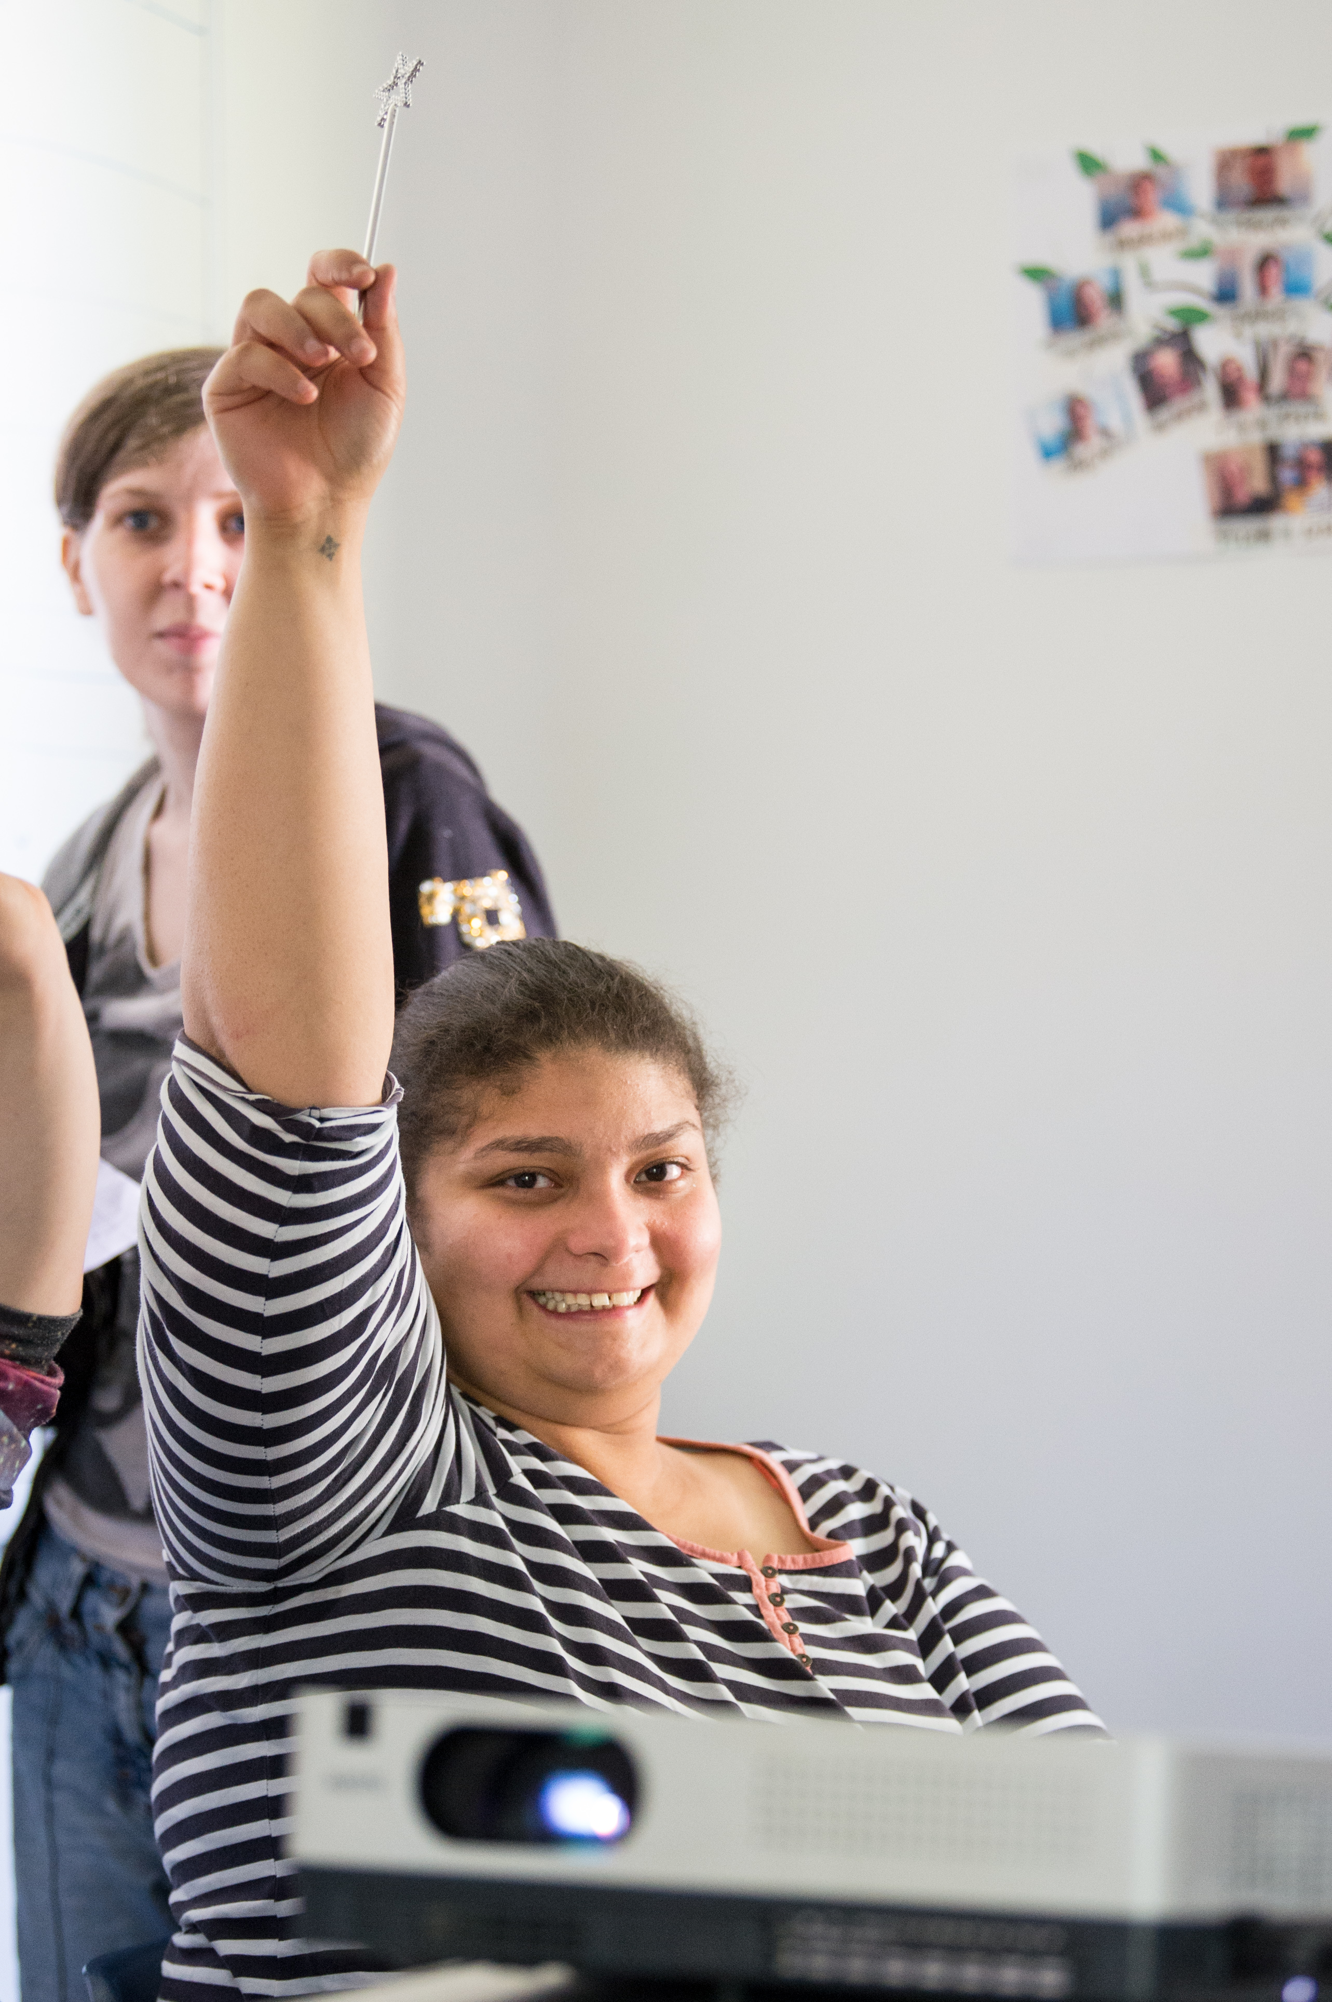
What young people gain
Learn to work independently and with others
Increased confidence and raised aspirations
Leadership, communication and creative skills
Reflect on their learning and develop meta-cognition
Notes:
Schools report that Arts Award has a positive impact on students’ literacy, engagement and attendance, as well as the key aspects outlined on the slide.
You can read more about the impact of Arts Award in the initial findings of the Arts Award Impact Study: http://www.artsaward.org.uk/resource/?id=4294
Case studies are available at https://blog.artsaward.org.uk/

Slide 7
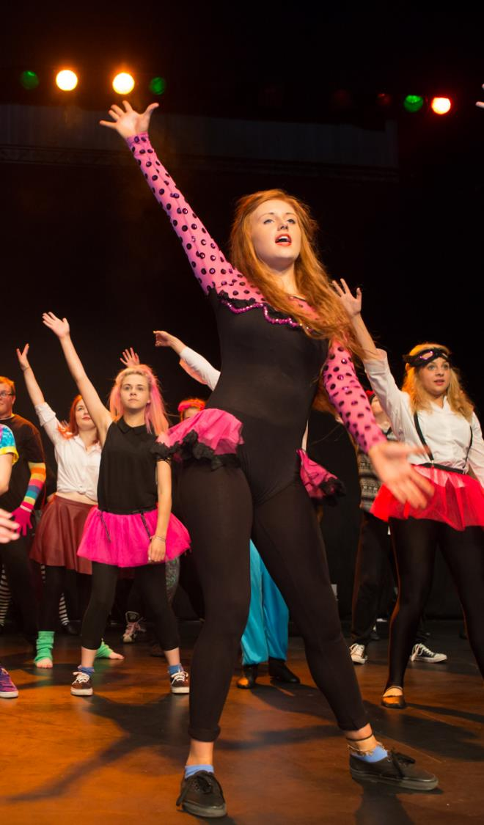
Arts Award portfolios
Arts Award is a portfolio-based qualification. Young people gather evidence of their progress in a portfolio.
Evidence for portfolios can be collected in a range of formats: e.g. photos, film, audio, written work, creative responses
Arts logs are available for Discover, Explore and Bronze which can be used as activity books to collect evidence.
Young people can create online portfolios by creating their own websites or blogs
Notes:
Ready made log books can be bought from our online shop https://shop.trinitycollege.com/pages/arts-award-explore
Free portfolio building templates can be downloaded from our resource library.
You can view more examples of young people’s portfolios at https://portfolios.voicemag.uk/

Slide 8

Benefits and outcomes
Contributes to Ofsted’s Spiritual, Moral, Social and Cultural development of pupils, can develop cultural capital and demonstrate a schools commitment to a broad and balanced curriculum.
Supports the development of students’ meta-cognition and vital 21st Century skills.
Can be delivered within the curriculum and across subject areas.
Notes:
Arts Award can help to demonstrate certain Ofsted criteria download the Arts Award and the Ofsted framework resource from our resource library.
Findings from the Arts Award Impact Study show that the award supports students’ meta-cognition – especially in the areas of self-reflection and leadership. More information in the summary of findings: https://www.artsaward.org.uk/site/?id=2544
Arts Award can be integrated into the curriculum across subject areas where the arts can be linked to subject matter. We have a number of resources exploring Arts Award’s links with English, Drama, Music, History and Art and Design and PSHE on our resource library.

Slide 9
Booking moderations for adapted assessment under VCRF
Why is Arts Award valuable
It’s a national qualification that can accredit young people’s work and will look good on their CVs
It helps develop employability skills such as communication, organisation, planning and team working; as well as building art form knowledge and creativity
It’s accessible: Arts Award measures individual personal progress and can be adapted to a range of art forms, activities and timeframes. Evidence can be collected in any format and doesn’t have to be written
It supports progression by acting as a bridge to support young people into further engagement with the arts, study or training
It builds confidence: Young people explore their own interests and reflect on their own personal progress, building confidence along the way
Notes:
You can read more about how Arts Award supports employability skills at our blog: https://blog.artsaward.org.uk/2015/10/05/employability-what-does-arts-award-have-to-offer
Arts Award has been delivered to young people of all abilities at a range of different settings, not only within formal education. It is a flexible award which focuses on how young people develop throughout. Arts Award measures each young person’s individual journey rather than the final outcome.

Slide 10
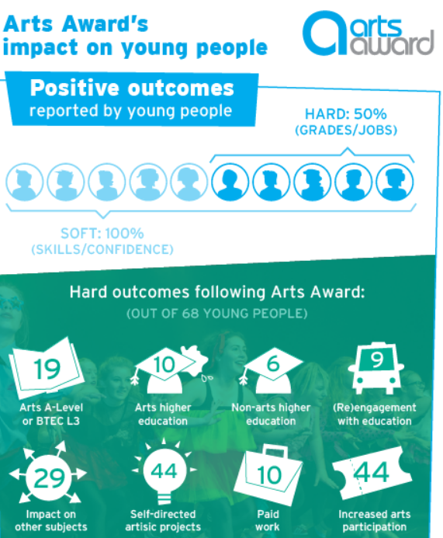
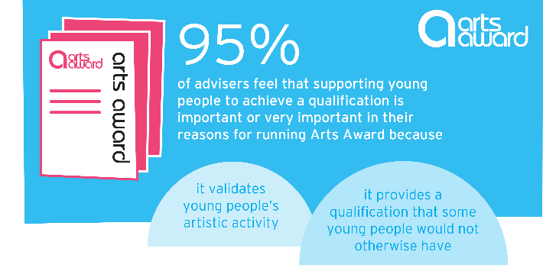
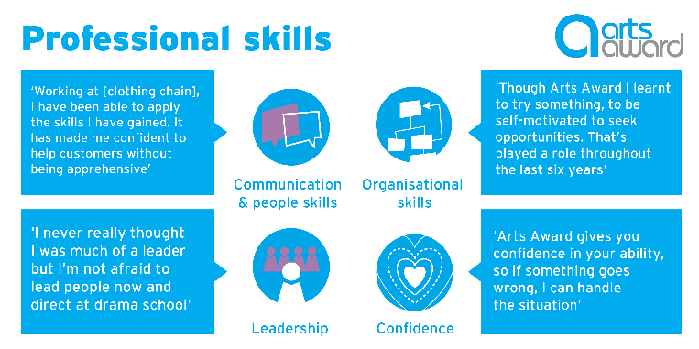
The Impact of Arts Award
Notes:
Results from the Arts Award impact study

Slide 11
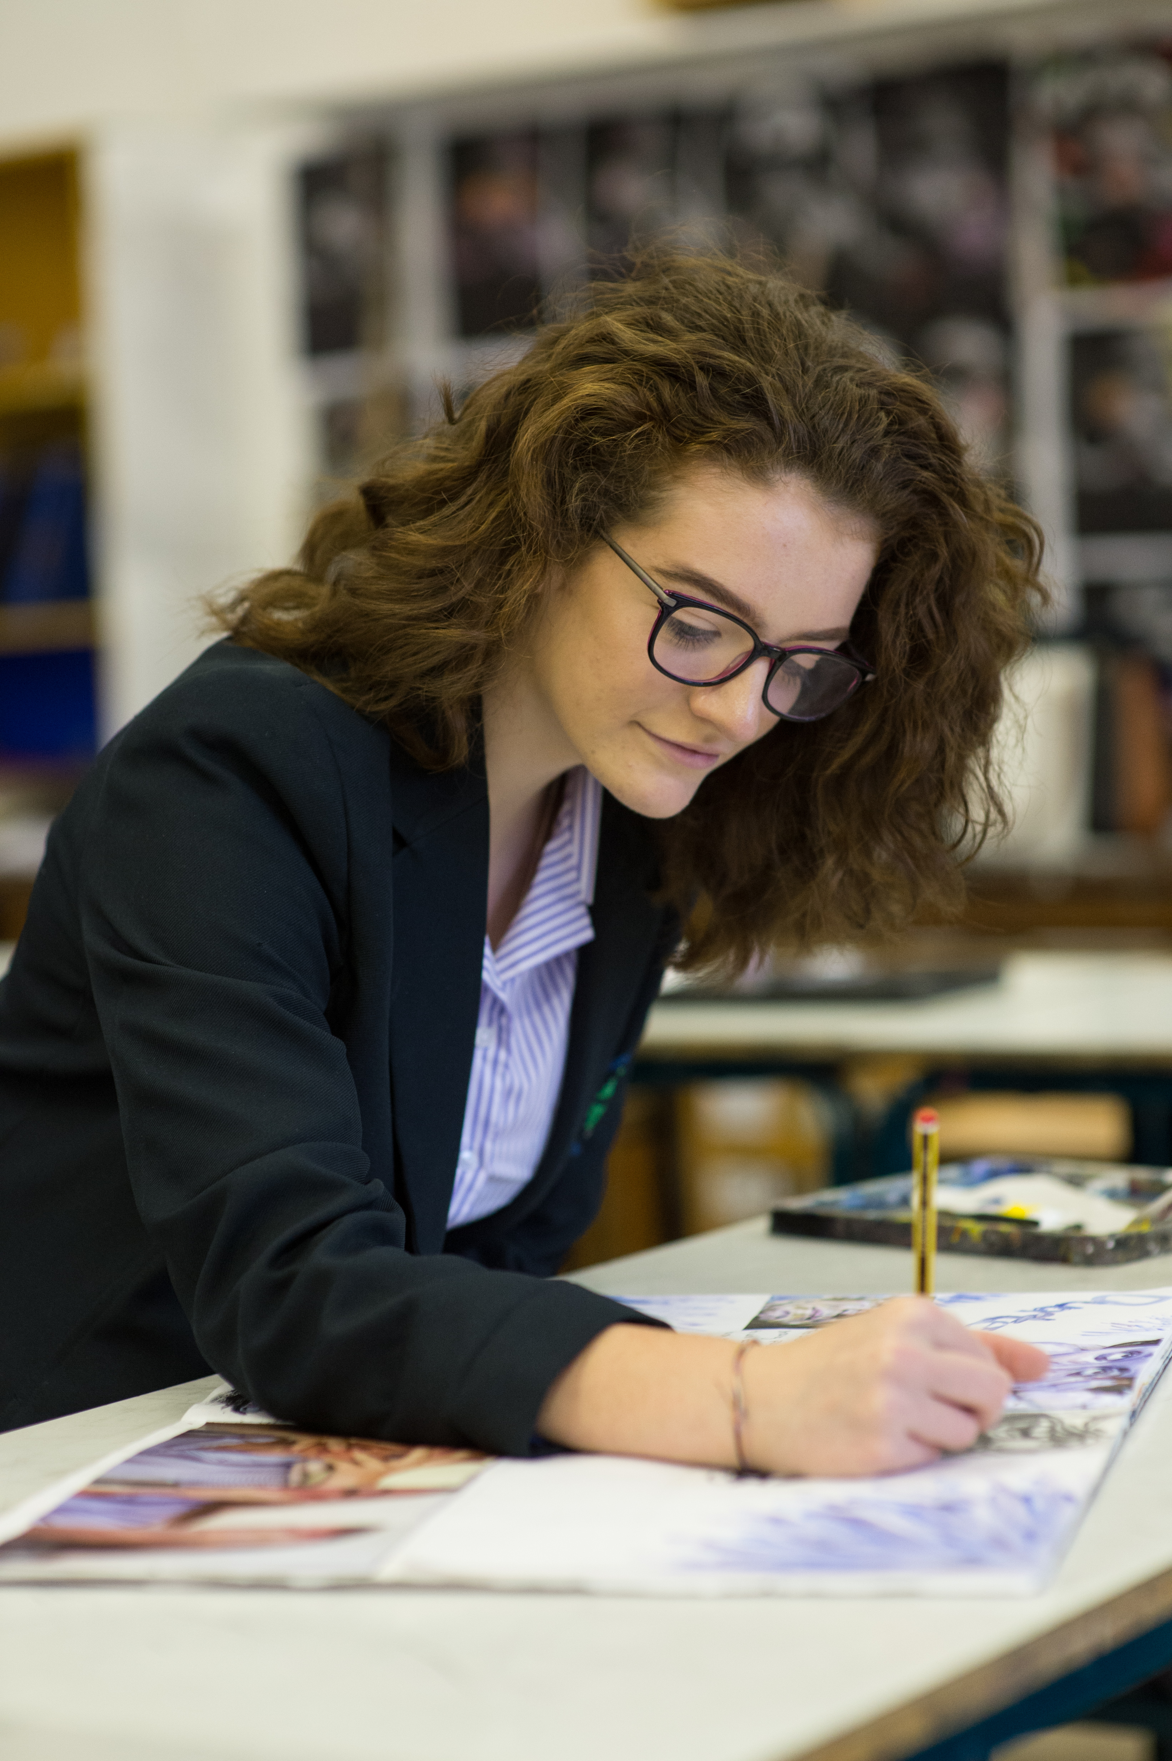
Arts Award in schools and colleges
‘From the moment I heard about Arts Award I knew it was the way arts should be taught. Being involved in Arts Award has been one of the most rewarding experiences of my teaching career.’
Christine Pearson, Arts Design & Technology Teacher, Thomas Estley Community College
Notes:
Arts Award in Schools & Colleges: slide is focused on this sector only. Delete or jump ahead if they don’t apply to your organisation
Arts Award and Schools https://www.artsaward.org.uk/site/?id=1989

Slide 12

Arts Award in arts and cultural organisations
‘Arts Award provides a fantastic framework for young people to discover and explore the arts, to develop leadership skills and investigate and enjoy the cultural landscape of their local area.’
Owen McNeir, Development & Marketing Director, Bath Festivals
Notes:
Arts Award in Arts and Cultural Organisations: slide is focused on this sector only. Delete or jump ahead if it doesn’t apply to your organisation
Arts Award and arts and cultural organisations https://www.artsaward.org.uk/site/?id=1980

Slide 13
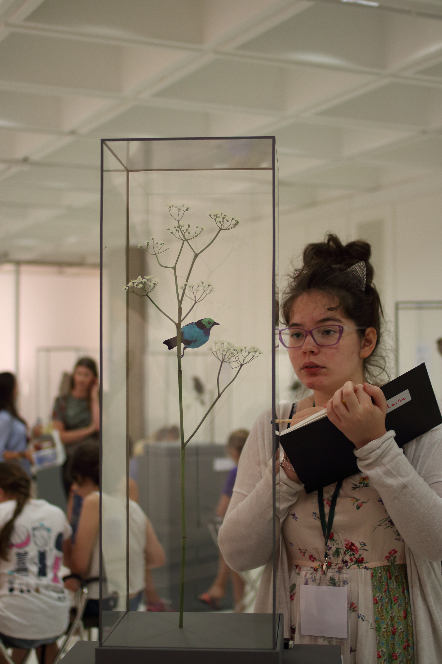
Arts Award in Youth and Community organisations
‘Arts Award gives us the flexibility to work through young people’s strengths. It provides a framework and validation for young people that contributes hugely to the work we do.’
Simon Glenister, Director, Noise Solution
Notes:
Arts Award in Youth & Community Organisations: slide is focused on this sector only. Delete or jump ahead if it doesn’t apply to your organisation
Arts Award and Youth and Community Organisations https://www.artsaward.org.uk/site/?id=1982

Slide 14








Arts Award partners
Arts Award works in partnership with a number of other national organisations to help even more young people explore their creativity through the awards, including:
Notes:
A full list of Arts Award partnerships can be found at www.artsaward.org.uk/partnerships

Slide 15
What other people say about Arts Award
Young people have developed skills in leadership, organisation, confidence and self esteem. These positive changes are not short lived, but have been transferred to pupils’ work across the curriculum. Pupils’ self belief is reinforced every time they look back at their Arts Award portfolios and certificates.
Claire Everett, Head of Art and Arts Award adviser, Cranborne Middle School
‘I love delivering Arts Award to young people in a variety of settings. Watching young artists take control of their own projects and slowly develop the confidence to take creative risks and step out of their comfort zone is wonderful to experience.’
Claire Platt, Education and Participation Manager, Peshkar Productions
‘Arts Award has been an inspiration to me. Completing my Bronze and being part way through my Gold has taught me that I am capable of more than I can imagine, I feel as if I have the freedom and inspiration to do anything I never thought I would be able to do, the opportunities I didn’t think I would have are just around the corner.’
Lauren, 14, Bronze Arts Award achiever, The Lowry Arts Centre
‘Libraries are changing; we need to appeal to a more diverse audience and to show our worth to external funding bodies. We feel that the best way to do this is to embed Arts Award in as much of our delivery for children and young people as we can as it provides excellent evidence to demonstrate the value of the projects we run and something concrete that children and young people can achieve and take forward.’ Liz Gardner, Library Development Officer, Staffordshire Libraries
Notes:
These are just some of the positive comments from Arts Award centres and achievers which we hope will inspire you and your colleagues to deliver Arts Award and highlight the impact doing the awards can have for young people, and the organisation.

Slide 16
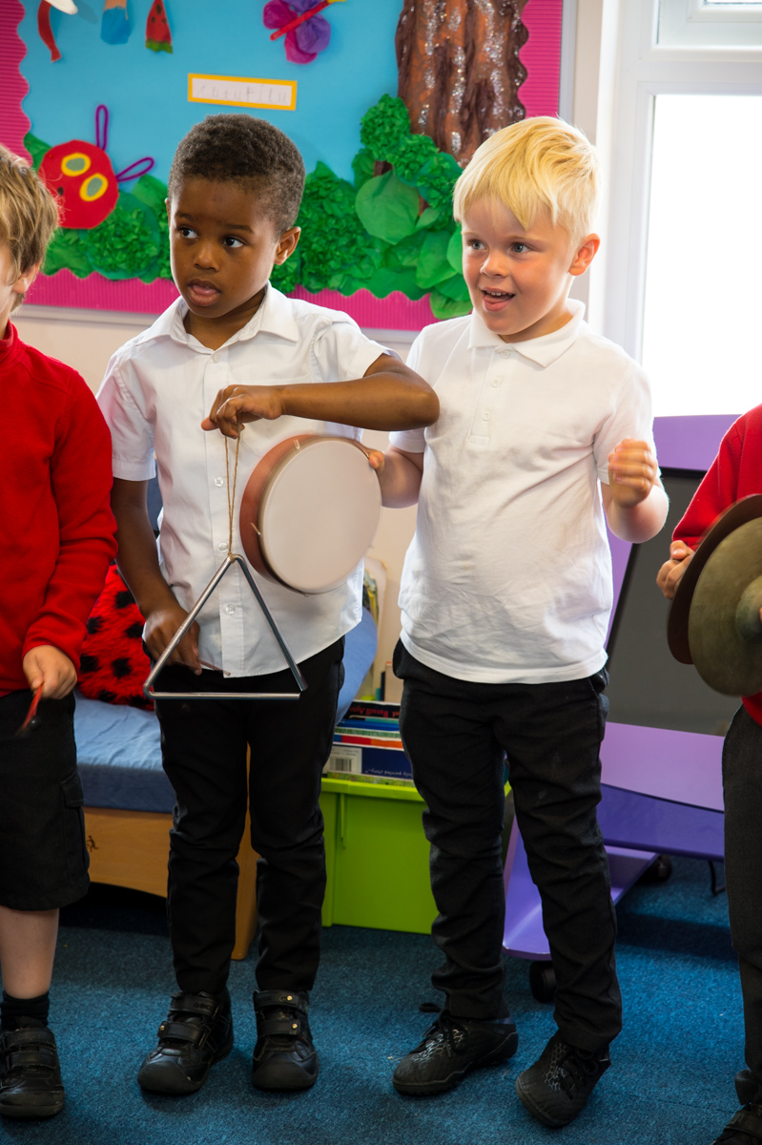
Get Started!
If you’re interested in getting going, remember that you need to be a trained Arts Award adviser for the levels you want to deliver. View upcoming training courses at artsaward.org.uk/training
Visit artsaward.org.uk/gettingstarted for more information
Notes:
Discover & Explore training is a half day
Bronze & Silver training is a longer half day
Gold training is a half day
All courses are delivered online.
There are group training discounts available, as well as a made to measure course offer. Visit the training pages of the website for more information.

Slide 17
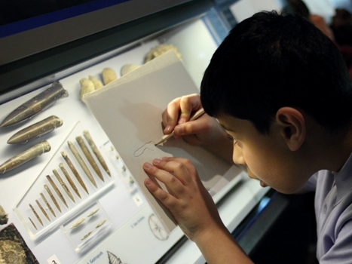
Any
Questions?

Slide 18
Support
support@trinitycollege.com
Helpdesk 0207 820 6178
www.artsaward.org.uk/resources
www.artsaward.org.uk/blog

